Slide 1
Blackbox Testing for Conversational Systems
David Klaper
Notes:
Hello everyone
I’m happy to tell you about our experience with testing some conversational systems before lunch
I’m David and I’m a Senior NLP and Software Engineer at Paixon.
We’re a small company focusing on developing chat and voice solutions.

Slide 2
Where does the experience come from
Various Voice and Chatbot projects
Personally highly involved in 3 voicebot projects
SBB train connections, prices and some infos: Okay Google spreche mit SBB
Localsearch find restaurant and reserve: Okay Google spreche mit Local
Money Key check your company finances: Money Key
Examples will be from or inspired by the SBB voice bot

Slide 3
Outline
Conversational systems need automated testing
What do we test and why is testing tricky
Generating insight without looking inside + examples
Conversational tests as a common language

Slide 4
What do I mean by conversational systems
Statistical NLP System
Training Data
User says what he wants
When does the train to Bern depart?
User need (intent)
Train Departure Time
Info provided (entities)
Train arrival: Bern
Bot Logic
The system replies
The next train to Bern departs at 1.29pm
Notes:
Mention projects! -> Experiences from a hand ful projects, I was very involved with 3 of them: SBB Trains, infos and ticket prices,
Money Key -> Trustee company, And Localsearch -> Voice bot to find restaurants and reserve tables
NLP System -> Explain blackbox (typically supervised) plus data obtaining logic + answer generation (deterministic)

Slide 5
What do we test and what would we like to test
What we test
Unit tests for bot logic (getting data, creating answers, setting context)
NLP tests giving the NLP system examples and testing its output
What we want to do more
Conversational tests for testing entire flows from start to user goal
Building comprehensive test sets → automatically collecting test cases
Why end-to-end tests are more difficult
Conversational Interfaces (e.g. Google Assistant & Alexa) require flows outside of our control for some functionality
Stability is depending on response wording which often changes close to releases
Notes:
Unit Tests domain logic
would like to test -> more conversational tests for logic testing
More automated collection of testcases to have a set where we can apply quality standards and have wider coverage
Conversational tests -> i want to buy a train ticket. Bot: Where do you want to go? … When do you want to travel ...
less useful end2end tests

Slide 6
Why are automated tests crucial?
Manual testing focuses on intentions of a change
Changing training data can cause unpredictable changes in other places
Without automated regression tests, these will cause bugs in production
Rule of Thumb: When a regression is caught in production it should be in some way covered in a test for the future
Notes:
Adding a new feature means new training material which can skew the balance.
Modifying an existing feature can apply

Slide 7
Why testing is tricky
Improving the training for one intent can cause unintended side effects in other intents → Often the failing test might even seem unrelated to the changes in the training data
It is very frustrating when fixing one test leads to another regression again and again; I have been tempted to just skip a test (Don’t!)
Notes:
Changed something about asking about the price of a ticket, suddenly some tests asking about delays don’t work anymore …
Don’t talk too long.

Slide 8
Generating insight without looking inside
When something unrelated fails it should be seen as a warning!
We use proprietary 3rd party NLP models, so even if the parameters were interpretable we do not have access to them → blackbox testing
Scanning the tests for patterns will inform you about the model
Compare the failing tests with the changes not just in content but in structure
Used words
Used entity annotations and their order
Used sentence structure (e.g. subordinate clauses or prepositional phrases)
Compare above also to similar still succeeding tests
Notes:
A sudden failure of existing tests means something changed.
It’s a warning that something could be wrong
This is where people stop but if they looked closer they could find underlying issues or root causes
but even more so we can use this to see what happens with similar tests that didn’t fail -> is it syntax, is it entities, is it a wrong annotation? lexical problems.
(often bugs can be caused by lexical sparsity in the training data)
Recent wrong annotation
Go over 2 examples but before that one tip -> check for words

Slide 9
Recognizing patterns in test failures 1
Training intent 1
Entity Order
Test failures: Wrong intent when order of entities is slightly changed
Even though we then fixed the wrongly recognized intent, other example kept appearing
We learned about the model that the order of the entities across intents must be balanced
Wrote a script to generate training templates with missing entity orders; This guided our further training
Training intent 2
Notes:
In SBB the structure of entities is often very similar -> departure, arrival, time in different versions and orders and different intents just have some different sentences
What is the prices for the ticket? Is the train … delayed? Is there space in the train?
Wrote a new feature -> existing intent test would suddenly recognize a different intent.

Slide 10
Recognizing patterns in test failures 2
Prepositions
Test failures: Station with preposition often not recognized e.g. just “Langnau” as departure and maybe “Emmental” + “Appenzell” as arrival
Our entities were built up as a sequence of station terms
We learned the model cares a lot about syntactic structure even if lexical features (“nach”) make it very clear what the arrival should be
Now prepositions are no station terms anymore and we have a separate list for such stations
Notes:
We tried to fix this with additional examples but it would break some tests again and again

Slide 11
Conversational tests as a common language
Conversational systems are different than normal business software
Language and communication is at its core
In “normal” software a common language between business and developers is important but hard to achieve
There are attempts to use language to describe software with language (Behavior Driven Development BDD)
Use this to our advantage
Discuss functionality in terms of actual examples or even test cases
We’re not there yet but we believe a language-oriented approach to testing is more successful in conversational systems because the interaction is language-based
Notes:
test-driven
bdd -> often doesntg really work in business software

Slide 12
Our current efforts for improving our tests
Developing a framework and a small library to ease writing NLP tests (called Don’t get me wrong)
dgmw.expect('When does the train to Bern depart').to.be.intent('Train Departure').and.have.entity('arrivalStation', 'Bern');
Ongoing improvements of the existing projects
Improving our development process and communication with our customers by focusing on conversation flow and concrete examples

Slide 13
Summary
Conversational systems without automated regression tests don’t work
It is possible to generate insight into what a conversational model is sensitive to with blackbox tests, e.g specific grammatical constructions or lexical problems
We believe test cases in conversational systems is particularly suited for use as a communication tool also with business stakeholders

Slide 14
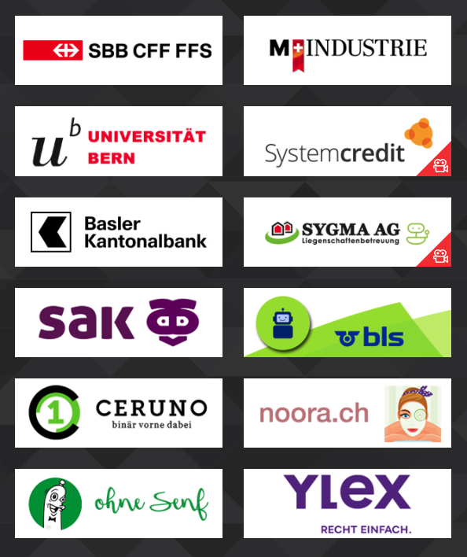
Our Company
Founded in 2015
Located in Schlieren, Zürich
We focus on Chatbots and Voicebots. Additionally we develop Individual Software.
We are 7 Employees

