Slide 1
Deep Learning for Text Analysis Where do we stand?
Jan Deriu
SwissText Conference, 9th June 2016
Notes:
Good morning. My name is Jan and I’m working as a research assistant at the Zurich university of applied sciences in Marks group. Today I will give you an overview of Deep Learning for Text Analysis is used, how it performs and where the challenges and limitations lie.

Slide 2
Intro

Slide 3
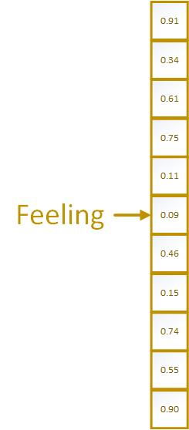
Language Model
Illustration: http://sebastianruder.com/word-embeddings-1/

Slide 4
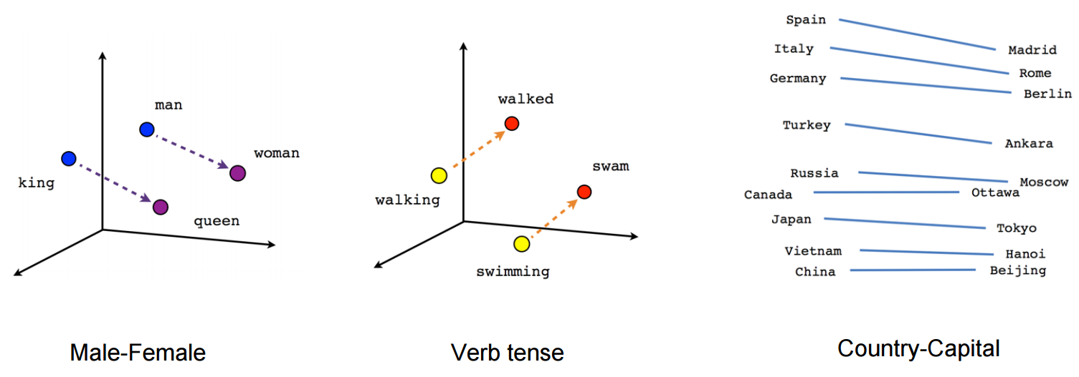
Properties
Image credits: https://www.tensorflow.org/tutorials/word2vec

Slide 5
Deep Learning – Convolutional Neural Networks
Illustration: Kim, Y. (2014). Convolutional Neural Networks for Sentence Classification

Slide 6
Task 1: Sentiment Analysis - Multilingual

Slide 7
3 Phase Learning
Illustration: Deriu, Jan, et al. "Leveraging Large Amounts of Weakly Supervised Data for Multi-Language Sentiment Classification."

Slide 8
Data – Distant Phase

Slide 9
Data – Supervised Phase – SemEval 2016

Slide 10
Results
Method | English | French | German | Italian
SL-CNN | 63.49 | 64.79 | 65.09 | 67.79
SL-CNN (no dist.) | 60.46 | 63.25 | 62.10 | 64.08
SVM | 60.61 | - | - | -
RF | 48.60 | 53.86 | 52.40 | 52.71

Slide 11
Competition Winner
SemEval 2016
EvalIta 2016

Slide 12
Summary Sentiment Analysis
Easy to adapt for multiple languages
Data-intensive

Slide 13
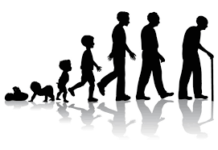
Task 2: Gender, Age and Variety

Slide 14
Task 2: Gender and Variety

Slide 15
Data - PAN 2017

Slide 16
Data: Variety
Language
English | Australian | Canadian | British | Irish | New Zealand | USA
Spanish | Argentina | Chile | Colombia | Mexico | Peru | Spain | Venezuela
Portuguese | Brazil | Portugal
Arabic | Egypt | Gulf | Maghrebi | Levantine

Slide 17
Data – Age PAN 2016

Slide 18
F1 scores: GRU – PAN 2017

Slide 19
Results: Architectures (English only)

Slide 20
Results: Architectures (English only)

Slide 21
Results – PAN 2016 (English only)

Slide 22
Summary
Good data yields good results
In Deep Learning the focus lies in finding and tuning the correct architecture

Slide 23
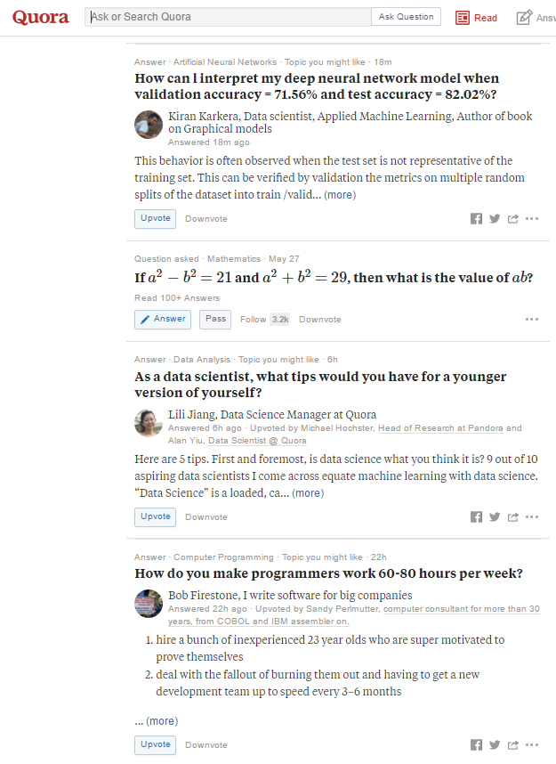
Task 3: Community Question Answering (cQA)

Slide 24
cQA - Data - SemEval 2017

Slide 25
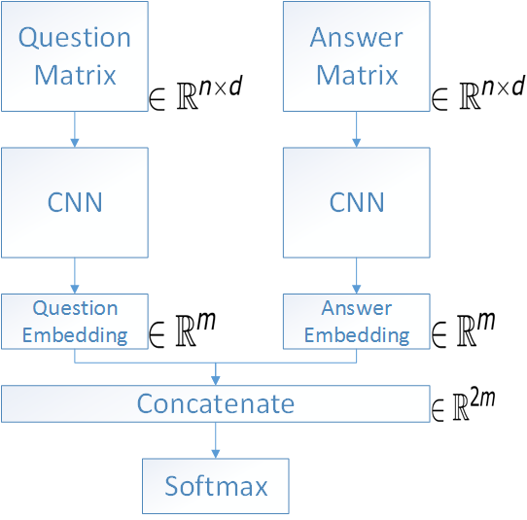
cQA - Approach - Siamese CNN

Slide 26
cQA – Results SemEval 2017

Slide 27
cQA - Summary
Deep Learning supports a large variety of architectures
Feautre-based approach works well

Slide 28
Conclusion
Deep Learning – very data-intensive
Not always better than feature-based approaches
From feature-engeneering to «archtiecture»-engeneering

Slide 29
Code
https://github.com/spinningbytes/deep-mlsa

