Slide 1
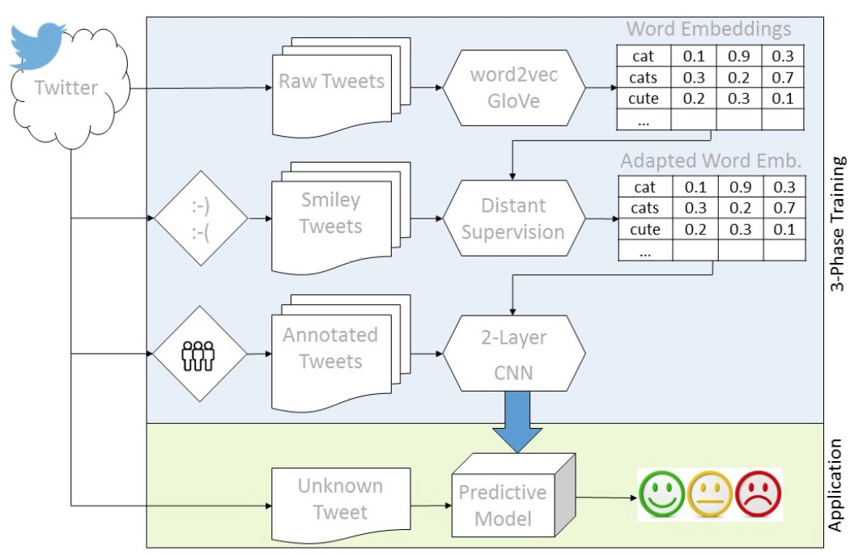
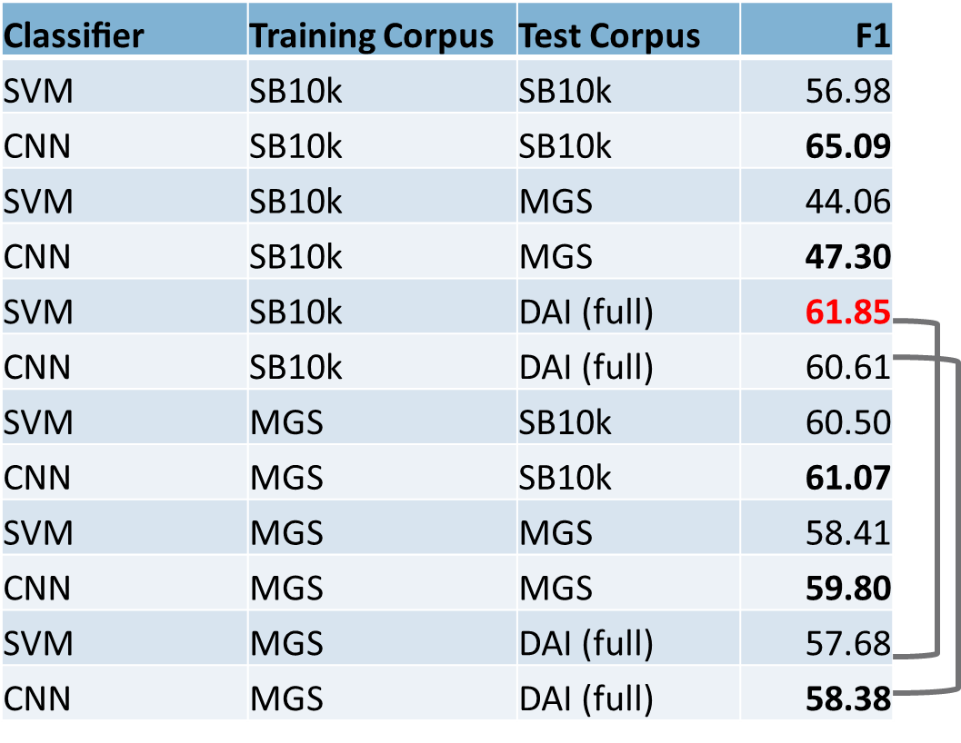
A Twitter Corpus and Benchmark Resources for German Sentiment Analysis
Zurich University of Applied Sciences (ZHAW) - Winterthur, Switzerland
SpinningBytes AG, Küsnacht, Switzerland
Mark Cieliebak Jan Deriu Dominik Egger Fatih Uzdilli
Available Corpora
New Corpus: SB-10k
Previously existing corpora in German:
DAI Tweets (1800 samples):
Too small for training complex models
MGS Corpus (109’130 samples):
Low quality of annotations
PotTS Corpus (7992 samples):
Annotations only on phrase-level
9738 German tweets
Labels: "positive", "neutral", "negative" and "mixed"
Each tweet annotated by 3 annotators
Designed to cover a wide variety of unigrams and topics
Benchmark for Sentiment Analysis in German
SVM System
CNN System
Features
n-grams, n = 1...4, POS-n-grams, n = 3...5, non-contiguous n-grams, n = 3...5
Character n-grams, n = 3...6
# upper-cased tokens, # of hashtags, # of POS tags
# continuous punctuations (max), last token punctuation (?, !)
# elongated words, # negated tokens
Lexicons: NRC-emotion, BingLiu, MQA, NRC-HashtagSentiment, Sentiment140, Sentiment140-3-class, RottenTomatoes-3-class)
Importance of high-quality
Word Embeddings
Results
CNN outperforms SVM in all but one case (red)
SB-10k generalizes better than MGS to unseen data
Resulting F1-Scores match state-of-the-art
Corpus and source code are publicly available at www.spinningbytes.com/resources

