Slide 1
Developing Highly Scalable and Adaptive Text Analytics Solutions in the Cloud
Petter Stengård
peter.stengard@microsoft.com
Principal Data Scientist
Business Application, Platform and Intelligence

Slide 2
Presentation Outline
Developing Scalable Text Analytics Solutions
Deep Learning for Text Analytics
Something Slightly Different

Slide 3
Part I Developing Scalable Text Analytics Solutions

Slide 4
What is Microsoft Social Engagement?
SaaS Application in Azure Cloud
Azure Storage, Event Hubs, Stream Analytics
10,000+ Active Customers (across the globe)
Live Firehose of Streaming Data from Social Sources (Twitter, Facebook, News, Blogs, YouTube, Disqus,...)
Processing and Analyzing ~400-500 posts/second

Slide 5
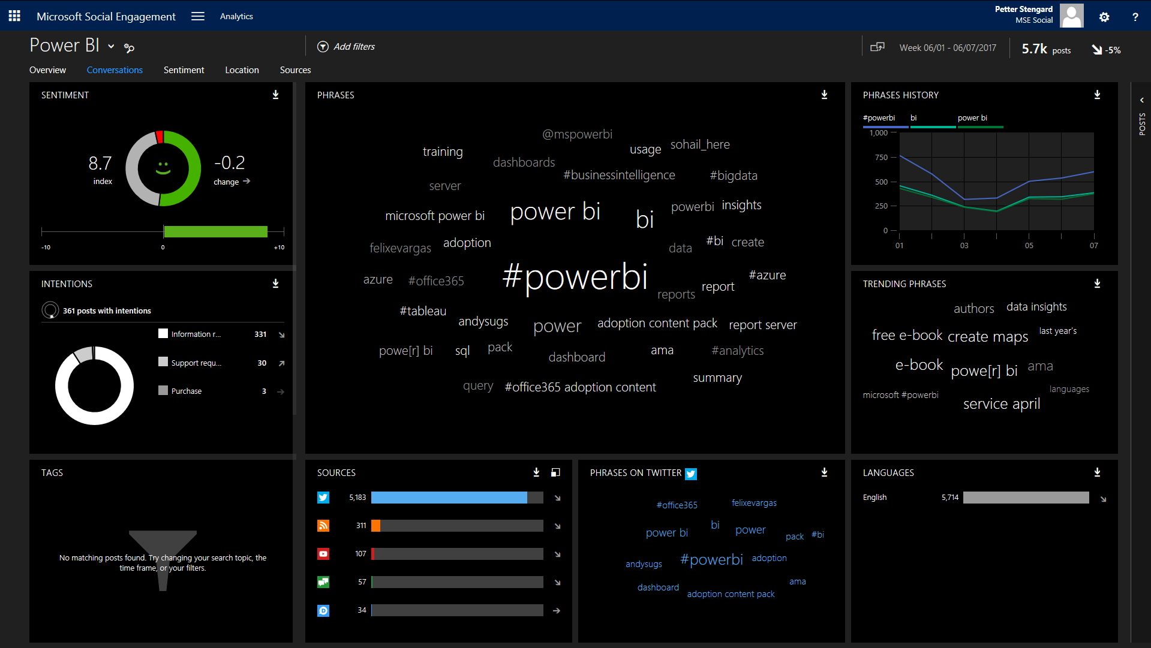
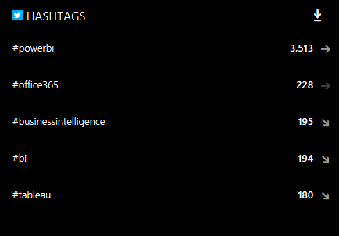

Slide 6
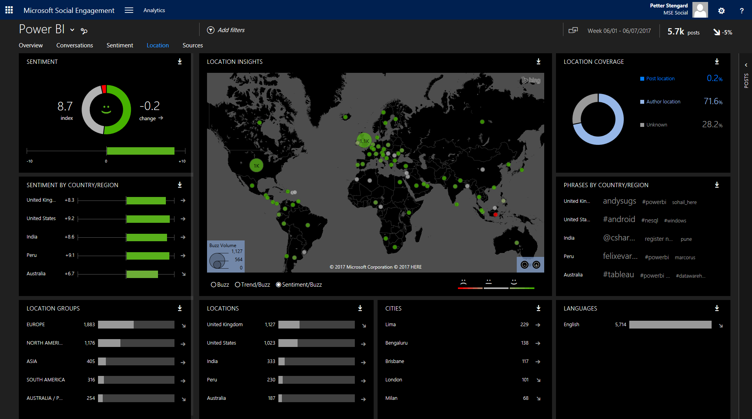

Slide 7
Text Analytics tasks in MSE
Sentiment Analysis
Intentions Analysis
Event Detection
Author Segmentation
Key Influencer Identification
Dynamic Topic Modeling
Spam/Profanity detection

Slide 8
How is the Sentiment Service Developed?
Azure Machine Learning (AML)
Distant Supervision using emoticons
18 languages 500M+ unlabeled posts
Add native language sentiment lexicons
Add emoticon lexicon
Python, SQL Transform, Vowpal Wabbit (VW)
AML Retraining API

Slide 9
Why use Azure Machine Learning?
Biggest advantage to a Data Scientist is that you can; create, test, operationalize, and manage your predictive services
The Data Science team does not need the IT team to implement predictive services into production
Notes:
Reliability (SLAs)
Security (Encryption, GDPR)
Scalability (global, throughput, elastic)
Accuracy (How well does the actual text analytics service score?)
Performance (milliseconds)
Functionality (language support)

Slide 10
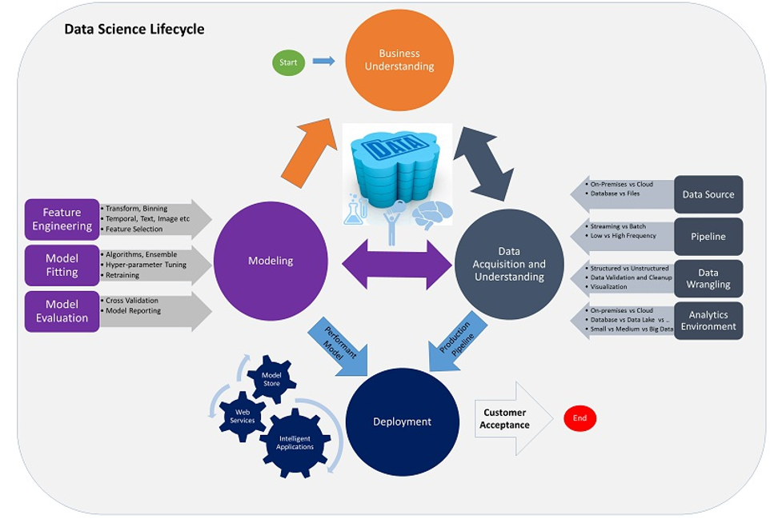

Slide 11
Why use Azure?
Reliability
Security
Scalability
Accuracy
Performance
Functionality
99.9% Availability
Notes:
Reliability (SLAs)
Security (Encryption, GDPR)
Scalability (global, throughput, elastic)
Accuracy (How well does the actual text analytics service score?)
Performance (milliseconds)
Functionality (language support)

Slide 12
What is Distant Supervision?
Distant Supervision is a learning method that uses large amounts of weakly labeled training data (based on heuristics/rules)

Slide 13
Why use Distant Supervision?
Acquiring human labeled data is time consuming and expensive in large volumes
We have access to vast amounts of unlabeled data
Suffers less from risks of overfitting and domain-dependence
Fast to scale to new languages
Simple to “refresh” models with new data

Slide 14
Examples using emojis for Sentiment label
Raw text:
“Aka the best manager ever 😎😎😎 http://t.co/bqm4spIuu7 twitter.com”
VW formatted:
1 '46_1 | en^aka en^the en^best en^manager en^ever
Raw text:
“now I have to struggle to go back to sleep 😒”
VW formatted:
-1 '188_-1 | en^now en^i en^have en^to en^struggle en^to en^go en^back en^to en^sleep

Slide 15
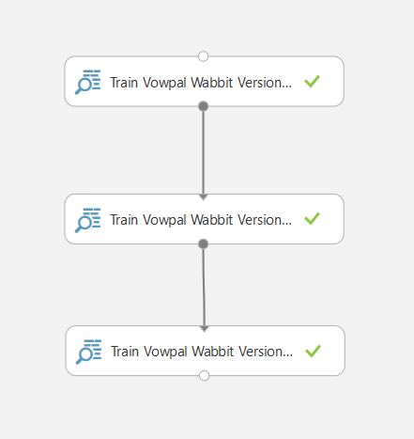
Train Baseline Sentiment Model
Large amount of social media posts labeled using distant-supervision
Native Sentiment lexicons
Emoticon lexicon

Slide 16
Trained model - significant features
Top-5 Most Positive
“no problem”
“omg justin”
“no prob”
“welcome”
“can’t wait”
Notes:
This slide is required. Do NOT delete. This should be the first slide after your Title Slide.
This slide should introduce the session by identifying how this information helps the attendee be more successful. Why is this content important?
This slide should call out what’s important about the session (sort of the why should we care, why is this important and how will it help the attendees be successful) as well as the key takeaways/objectives associated with the session. Call out what attendees will be able to execute on using the information gained in this session. What will they be able to walk away from this session and execute on.
Good Objectives should be SMART (specific, measurable, achievable, realistic, time-bound). Focus on the key takeaways and why this information is important to the attendee.

Slide 17
Trained model significant features
Notables
“hawt” (positive - having a wonderful time)
“fave” (positive - favorite)
“should deff” (positive - should definitely)
“brill” (positive - brilliant)
“fasho” (positive - for sure)
“crine” (negative - I’m crying)
“diam” (negative - “die in a mosh(pit)”)
Notes:
This slide is required. Do NOT delete. This should be the first slide after your Title Slide.
This slide should introduce the session by identifying how this information helps the attendee be more successful. Why is this content important?
This slide should call out what’s important about the session (sort of the why should we care, why is this important and how will it help the attendees be successful) as well as the key takeaways/objectives associated with the session. Call out what attendees will be able to execute on using the information gained in this session. What will they be able to walk away from this session and execute on.
Good Objectives should be SMART (specific, measurable, achievable, realistic, time-bound). Focus on the key takeaways and why this information is important to the attendee.

Slide 18
Trained model significant features
Further refinements necessary
“no school” (positive)
“no class” (positive - likely different in our domain)
“the man” (positive: as in “you the man”)
“where are” (negative: “where are you and I'm so sorry 😢 #imissyou")
Notes:
This slide is required. Do NOT delete. This should be the first slide after your Title Slide.
This slide should introduce the session by identifying how this information helps the attendee be more successful. Why is this content important?
This slide should call out what’s important about the session (sort of the why should we care, why is this important and how will it help the attendees be successful) as well as the key takeaways/objectives associated with the session. Call out what attendees will be able to execute on using the information gained in this session. What will they be able to walk away from this session and execute on.
Good Objectives should be SMART (specific, measurable, achievable, realistic, time-bound). Focus on the key takeaways and why this information is important to the attendee.

Slide 19
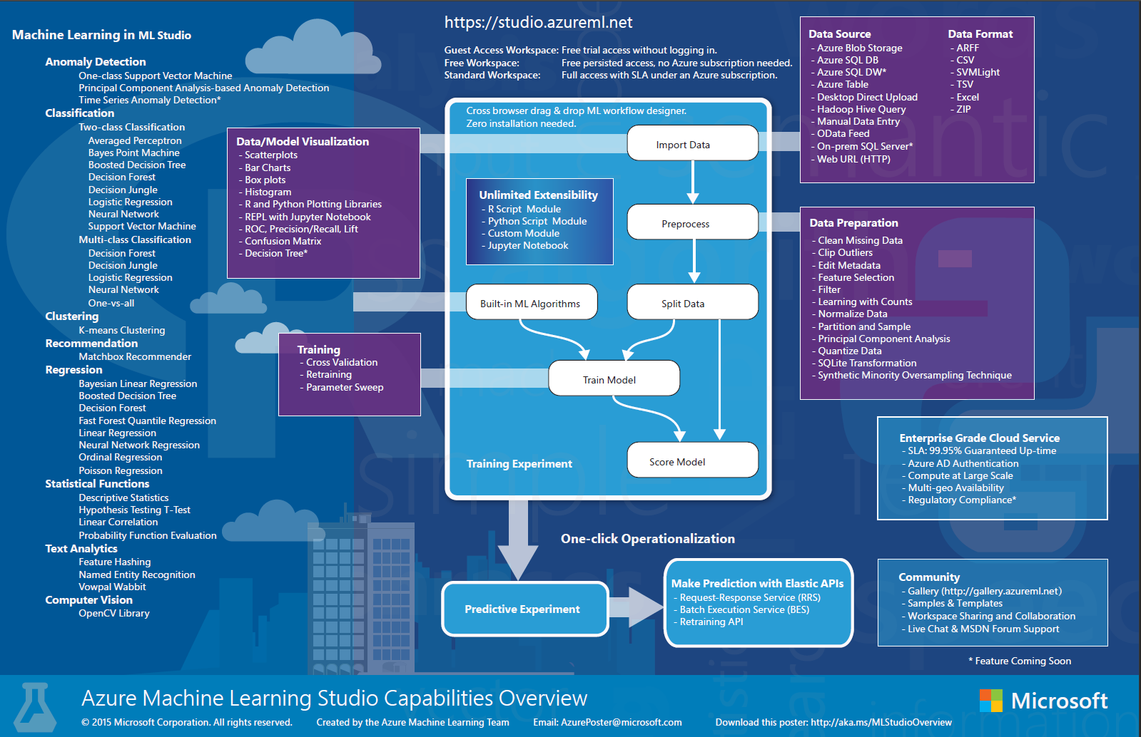

Slide 20
In real-estate - Location is everything! In text analytics - Context is everything!
Does this statement reflect positive or negative sentiment?
“easyJet or Lufthansa????? I prefer KLM!”
It depends on the context - In this case, who is the interpreter?

Slide 21
Context
In another situation, context may be the “topic” of the text.
E.g. “tears” and “crying” are generally interpreted as negative in social media domains, however, not so in movie reviews. Movie reviews claiming people were “brought to tears” are most often positive.

Slide 22
Context is captured through Adaptive Learning
Customers initially use baseline model web service
As they curate sentiment (edit predictions), a customer specific model and scoring service is created
Customer models are automatically retrained and scoring services updated continuously
Thousands of our customers are running on their customer specific models

Slide 23
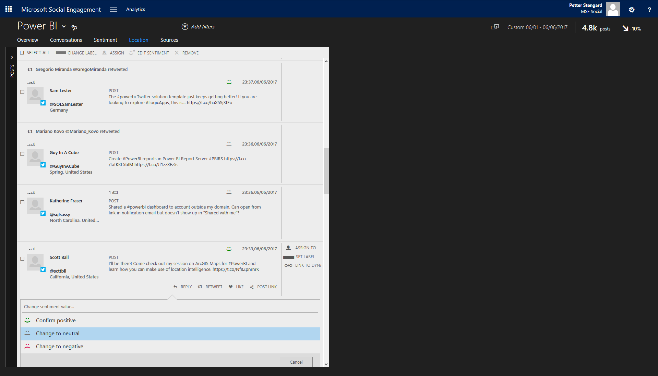

Slide 24
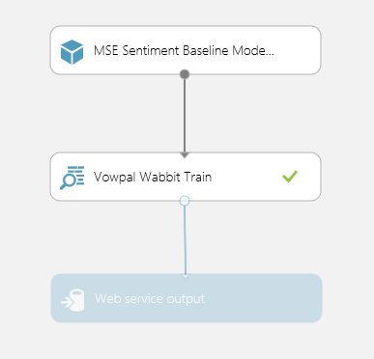
Training Web Service
Start with baseline model
Processed customer data gets added here
Output is a model which is used to patch the customer endpoint

Slide 25
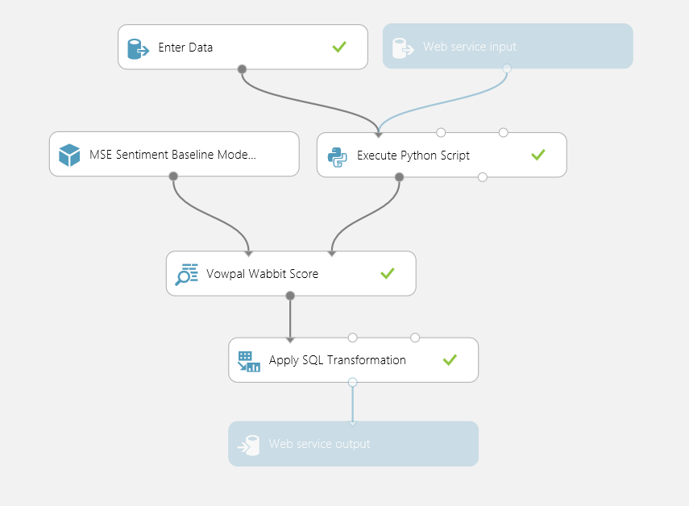
Scoring Web Service
Model gets automatically updated for customers who curate sentiment

Slide 26
Consuming AML Web Services
Request-Response Service (RRS): A low latency, highly scalable service
Batch Execution Service (BES): An asynchronous service that scores a batch of data records
AML web services use REST interfaces

Slide 27
RRS Web Service Scaling
Up to 200 concurrent calls/endpoint (auto-scaling)
Create multiple endpoints for higher throughput
Example: 5 endpoints where each request takes 50ms Max throughput=1000/50*200*5=20,000 requests/s
Up to 10,000 endpoints per web service

Slide 28
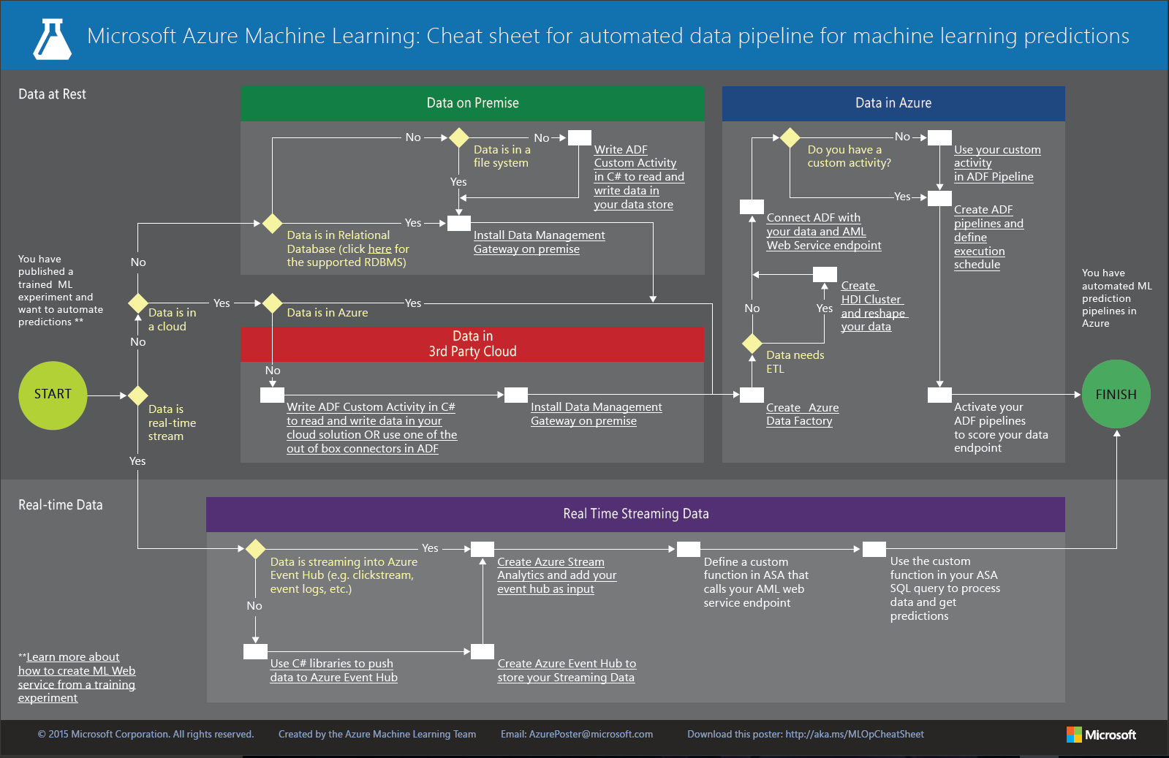

Slide 29
Part II Deep Learning for Text Analytics

Slide 30
State-of-the-art in NLP according to Stanford*
Mostly solved tasks | Spam detection Parts of speech tagging Named entity recognition
Making good progress | Machine translation Sentiment analysis Word sense disambiguation Information Extraction
Still really hard | Question and answering Paraphrasing Summarization Dialog
https://research.googleblog.com/2016/09/a-neural-network-for-machine.html
*) A bit dated: https://www.youtube.com/watch?v=nfoudtpBV68

Slide 31
Deep Learning Accuracy Breakthroughs
Speech recognition – 2012 30% accuracy improvement [Li Deng]
Image recognition - accuracy improves from 77% to 94% (CIFAR-10) [A. Kaparthy]
2015 Microsoft outperforms humans on ImageNet competition using ResNet-152 (error rate is reduced from 28% to 4.5% in last 5 years) [Microsoft]
8% accuracy improvement in Higgs Boson particle detection [Baldi]
Language Translation [Wu]

Slide 32
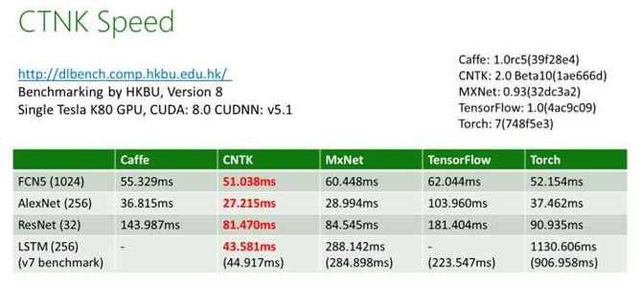
Open Source Deep Learning Software
Microsoft Cognitive Toolkit (CNTK)
Fastest deep learning software in the industry
Open source, available on github
Scales across thousands of GPUs
API C++/Python(Keras)
Speed (“5-10x faster”)

Slide 33
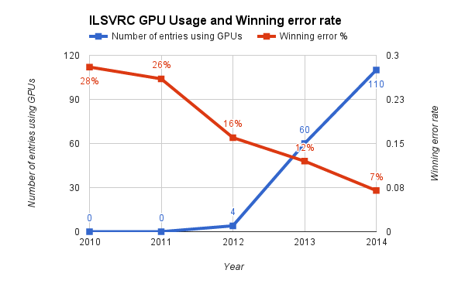
Computing resources
Training Deep Neural Networks is compute intensive and requires use of GPUs
GPUs provide 10x+ training speedup
Large scale GPU clusters are available in Azure for processing deep learning tasks
Scoring DNNs can be done on CPUs

Slide 34
Example: Azure Data Science VM
Platform:
Windows or Linux
Machine Learning tools:
CNTK
Vowpal Wabbit
XGBoost
Rattle
mxnet
Weka
Apache Drill
Python and R libraries
General tools:
Microsoft R Server
Anaconda Python
Jupyter Notebook
Visual Studio
SQL Server

Slide 35
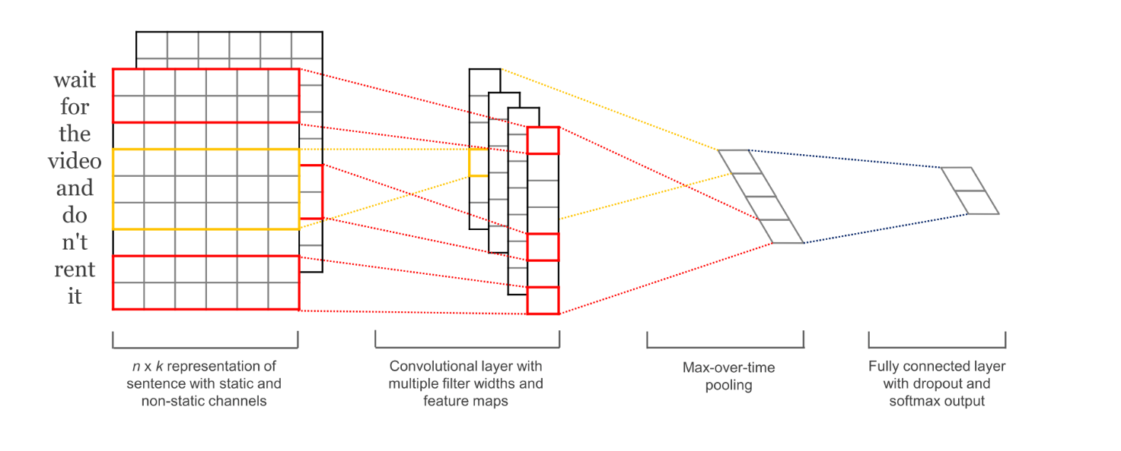
Convolutional Neural Networks (CNN)
Embedding
Convolutional layer(s)
Global Max Pooling
Fully connected dense layer
Dense output layer

Slide 36
ResNet “for text”
text
Embedding
3x1 conv, 64
3x1 conv, 64
3x1 conv, 64
Based on architecture used in Microsoft’s Residual Network which won the ILSVRC (ImageNet Large Scale Visual Recognition Challenge) classification competition in 2015.
Fully Convolutional
Residual shortcuts
Useful for networks with very large numbers of layers
3x1 conv, 128
3x1 conv, 128
3x1 conv, 128
3x1 conv, 256
3x1 conv, 256
3x1 conv, 256
3x1 conv, 512
3x1 conv, 512
3x1 conv, 512
global max pooling
Deep Residual Learning for Image Recognition
dropout
Very Deep Convolutional Networks for Text Classiﬁcation (Yann Le Cun, et al.)
fc 1

Slide 37
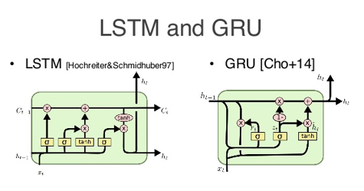
Recurrent Neural Networks (RNN)
Embedding
LSTM and GRU
Bidirectional
Last layer in RNN
Fully connected dense layer
Dense output layer
[C. Olah]

Slide 38
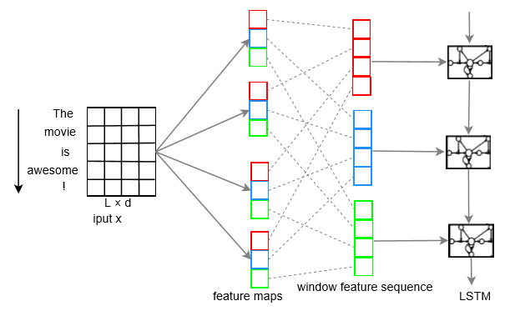
Hybrid versions of RNNs and CNNs
Convolution+max pooling and last layer of RNN spliced together
RNN -> Convolution -> Dense
Convolution -> RNN -> Dense
Dense output layer (tanh)
[Zhou]

Slide 39
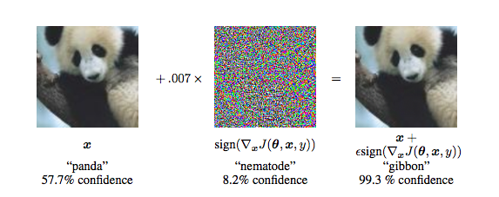
“Not so fast”
Although deep neural networks can produce record breaking accuracies, they still suffer from “naïve” deficiencies
“We can take any arbitrary image and classify it as whatever class we want by adding tiny, imperceptible noise patterns” [A. Kaparthy]
[Goodfellow]

Slide 40
Data
Training
40 million pos/neg English social media posts labeled using distant-supervision
SemEval 2013 training dataset (8,785 rows)
IMDB Movie Review training dataset (25k rows)
Amazon product reviews training dataset (3.6 million rows)
Evaluation
Semeval 2013 test dataset (3,809 rows)
IMDB Movie Review test dataset (25k rows)
Amazon product reviews test dataset (400k rows)

Slide 41
Data
Training
40 million pos/neg English social media posts labeled using distant-supervision
SemEval 2013 training dataset (8,785 rows)
IMDB Movie Review training dataset (25k rows)
Evaluation
Semeval 2013 test dataset (3,809 rows)
IMDB Movie Review test dataset (25k rows)

Slide 42
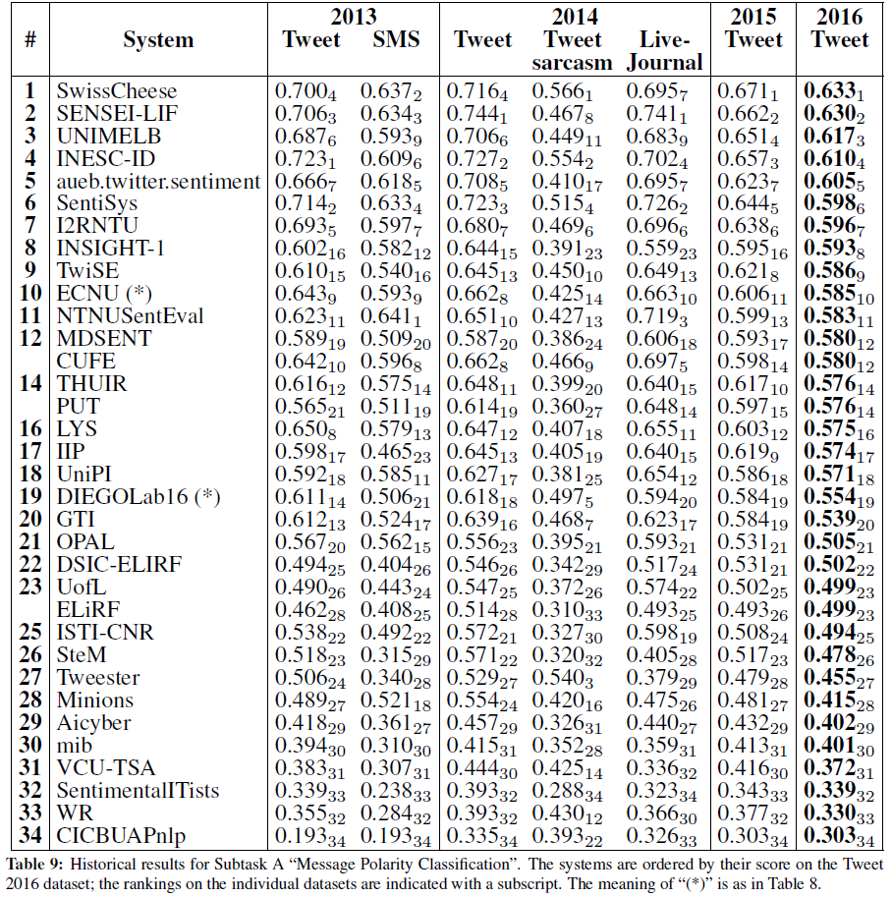
SemEval 2016 published results
2013 Tweet
System | F1-Macro (pos/neg)
MSE Baseline + SemEval training data | 0.664
MSE Baseline (internal lexicons added) | 0.626
CNTK LSTM (only distant-supervision data) | 0.617
VW Linear Regression (only distant-supervision data) | 0.590
http://alt.qcri.org/semeval2016/task4/data/uploads/semeval2016_task4_report.pdf

Slide 43
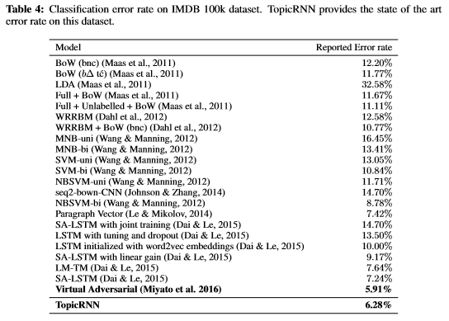
IMDB Movie Reviews
Note: Movie reviews with words like “tears” and “crying” receive high ratings, social media posts with the same words generally receive low sentiment scores.
System | Error rate
VW Linear Regression (only IMDB training data) | 9.4%
MSE Baseline + IMDB training data | 16.4%
MSE Baseline (only distant-supervision data) | 26.8%
TopicRNN: A Recurrent Neural Network With Long-Range Semantic Dependency
Adversarial Training Methods For Semi-Supervised Text Classification
Notes:
Not much separation between RNNs and CNNs in general for deep text.

Slide 44
Amazon Reviews
Amazon Polarity
System | Error rate
VW Linear Regression (only Amazon training data) | 5.23%
Very Deep Convolutional Networks for Text Classiﬁcation (Yann Le Cun, et al.)

Slide 45
Things we are looking into…
Include context (topics, embeddings,…) as separate features, TopicRNN [Dieng], Contextual LSTMs [Ghosh]
Character n-grams and punctuations (as in NMT systems)
Adversarial Training and Generative Adversarial Networks (GANs)
Evolutionary learning (interesting paper from OpenAI), Particle Swarm Optimization, Synthetic Gradients, etc…

Slide 46
Conclusions
MSE Sentiment v.5 (currently on PROD) does quite well compared to latest top research implementations
Domain adaptation can be improved, e.g. by increasing the learning rate from 0.01 to 0.5 when applying additional training data
State-of-the-art deep learning text classification still has some way to go before achieving similar improvements as have been made for image analysis (others are coming to the same conclusion)

Slide 47
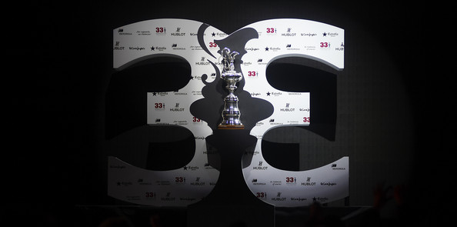
Part III Something slightly different - 33rd America’s Cup

Slide 48
Setting the stage for 2010
Defender | Challenger
Alinghi Ernesto Bertarelli, Executive in Pharmaceuticals industry | BMW Oracle Racing Larry Ellison, Founder and CEO of Oracle Corporation
Alinghi had won twice previously
Oracle had lost twice previously
“Battle Between Two Billionaires”
Almost no limitations “max 90 feet long and 90 feet wide”

Slide 49
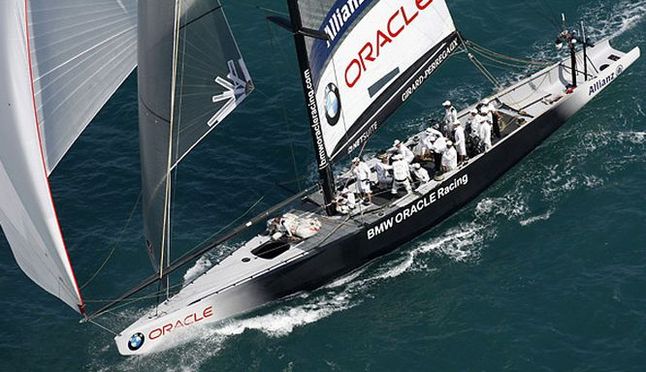
“Here’s the data.
Can you find something interesting?”

Slide 50
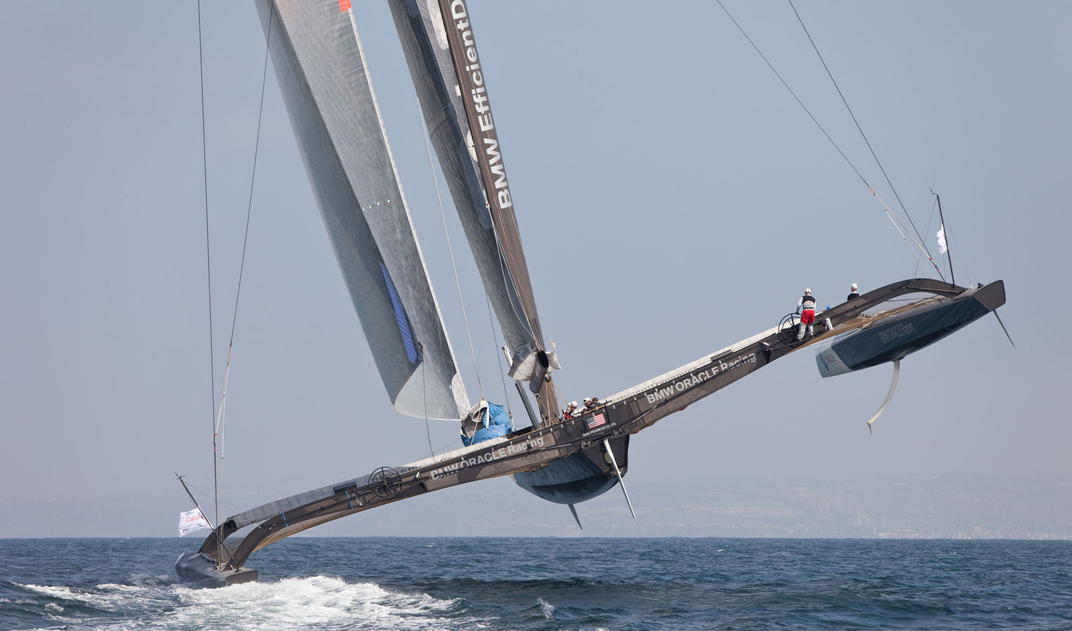

Slide 51
Data
Hundreds of sensors collecting data every 1/10th second
1 hour of sailing about 100 million data points
Target of interest: VMG
What is measured: wind speeds, angles, heeling, sail shape, dagger boards, rudders, mast rotation, stress, etc., etc.

Slide 52
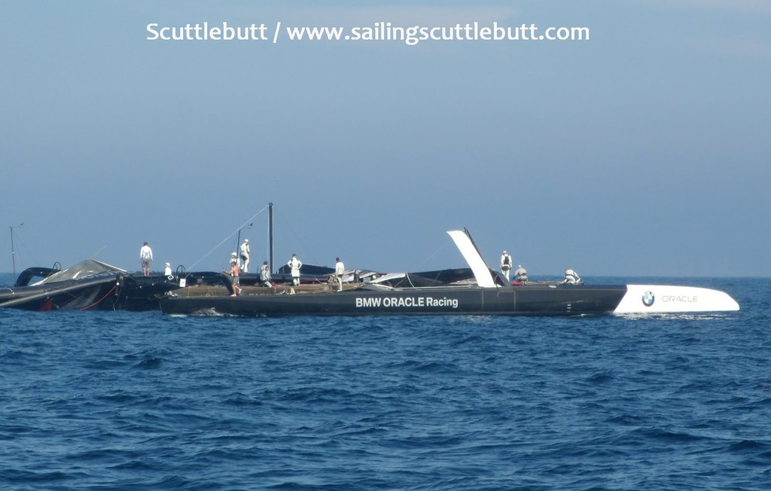
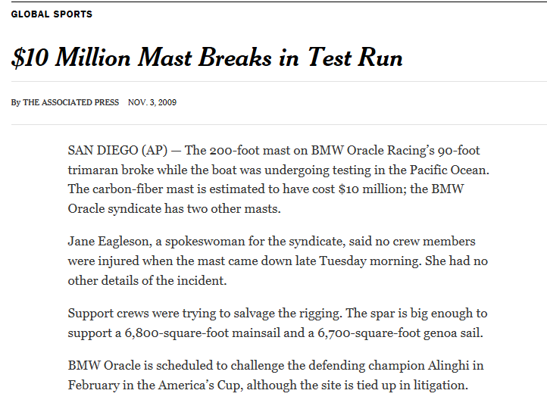

Slide 53
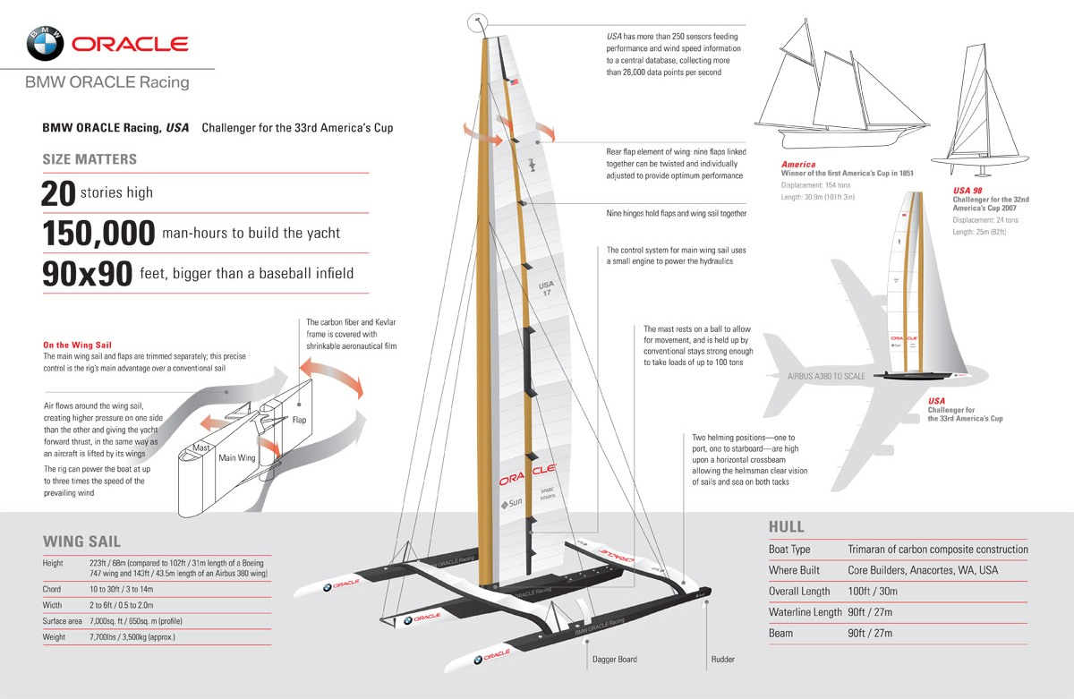

Slide 55
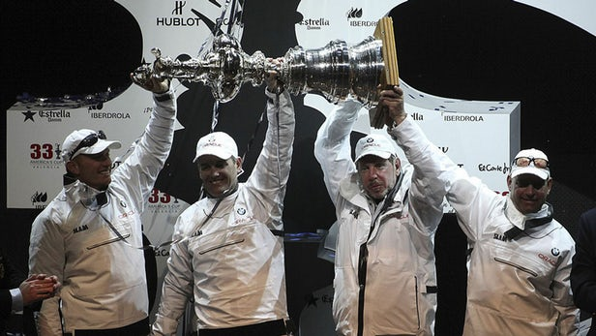
“Space-age trimaran wins back America’s Cup for US”

